Slide 1

Dr. Arockia Xavier Annie R
Asst. Professor, DCSE
CEG, Anna University
Chennai -600025
Email: annie@annauniv.edu

Slide 2


Slide 3
Outline
Role of lexical analyzer
Specification of tokens
Recognition of tokens
Finite Automata
Lexical analyzer generator
Design of lexical analyzer generator
Dr.Arockia Xavier Annie R, DCSE, Anna University

Slide 4
The role of lexical analyzer
token
Source
program
Lexical Analyzer
Parser
To semantic
analysis
getNextToken
Symbol
table
Dr.Arockia Xavier Annie R, DCSE, Anna University

Slide 5
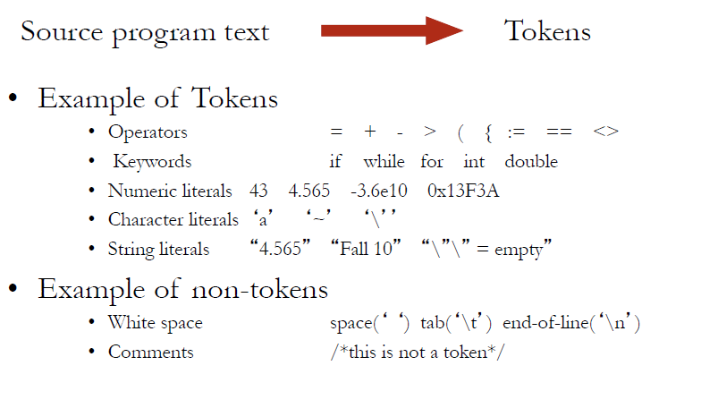
What is a Lexical Analyzer
Dr.Arockia Xavier Annie R, DCSE, Anna University

Slide 6
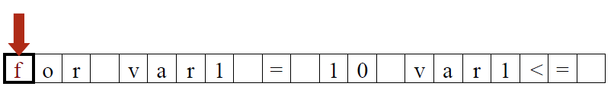
Lexical Analyzer in Action
Dr.Arockia Xavier Annie R, DCSE, Anna University

Slide 7
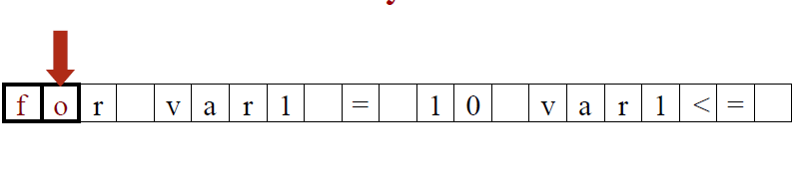
Lexical Analyzer in Action
Dr.Arockia Xavier Annie R, DCSE, Anna University

Slide 8
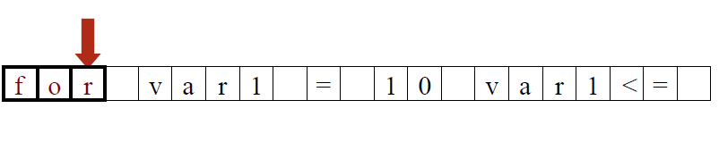
Lexical Analyzer in Action
Dr.Arockia Xavier Annie R, DCSE, Anna University

Slide 9
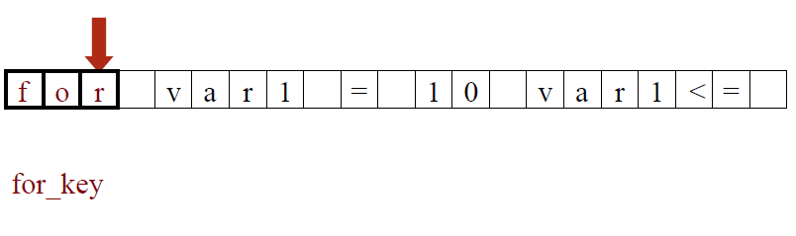
Lexical Analyzer in Action
Dr.Arockia Xavier Annie R, DCSE, Anna University

Slide 10
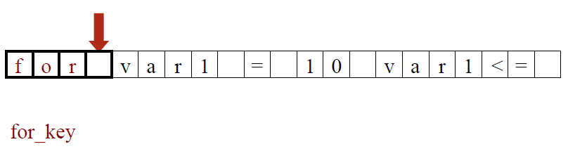
Lexical Analyzer in Action
Dr.Arockia Xavier Annie R, DCSE, Anna University

Slide 11
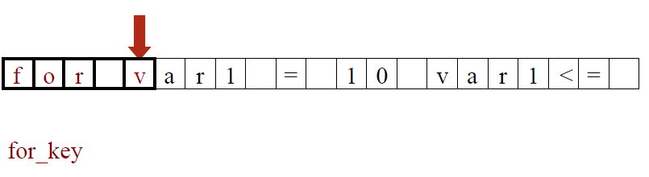
Lexical Analyzer in Action
Dr.Arockia Xavier Annie R, DCSE, Anna University

Slide 12
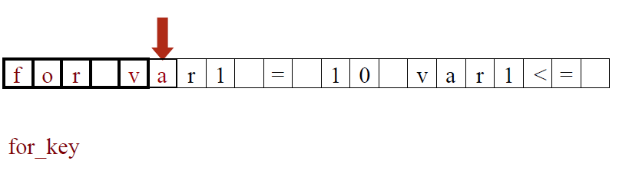
Lexical Analyzer in Action
Dr.Arockia Xavier Annie R, DCSE, Anna University

Slide 13
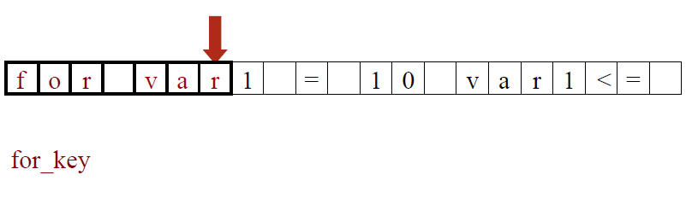
Lexical Analyzer in Action
Dr.Arockia Xavier Annie R, DCSE, Anna University

Slide 14
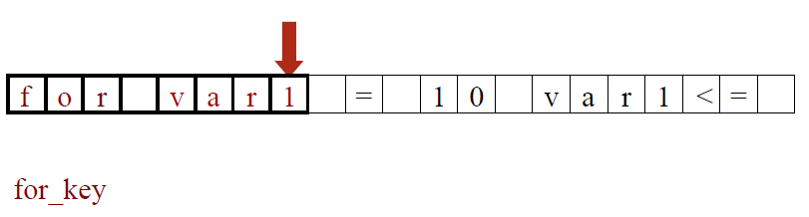
Lexical Analyzer in Action
Dr.Arockia Xavier Annie R, DCSE, Anna University

Slide 15
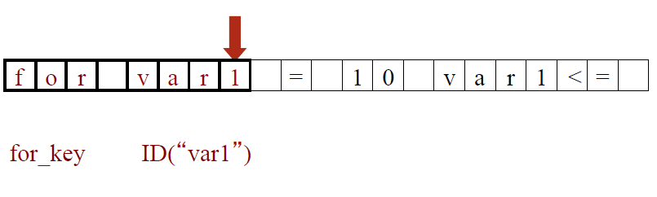
Lexical Analyzer in Action
Dr.Arockia Xavier Annie R, DCSE, Anna University

Slide 16
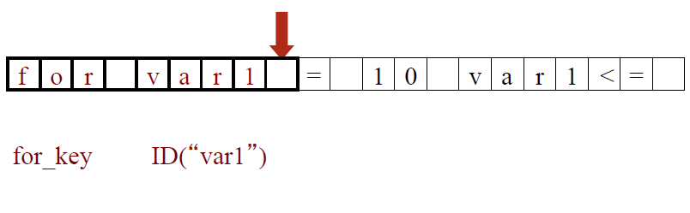
Lexical Analyzer in Action
Dr.Arockia Xavier Annie R, DCSE, Anna University

Slide 17
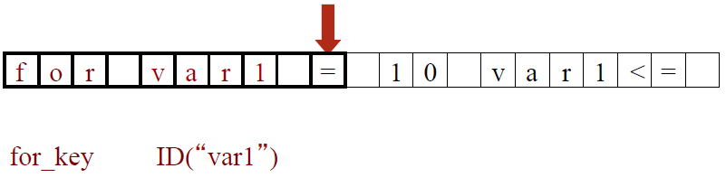
Lexical Analyzer in Action
Dr.Arockia Xavier Annie R, DCSE, Anna University

Slide 18
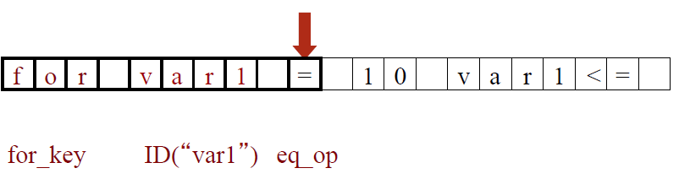
Lexical Analyzer in Action
Dr.Arockia Xavier Annie R, DCSE, Anna University

Slide 19
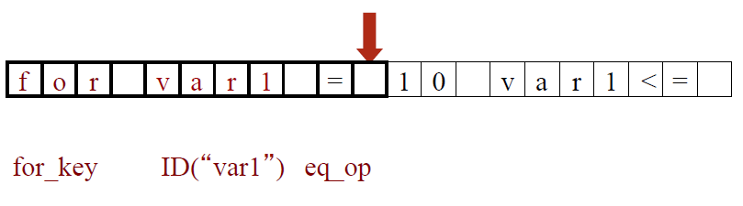
Lexical Analyzer in Action
Dr.Arockia Xavier Annie R, DCSE, Anna University

Slide 20
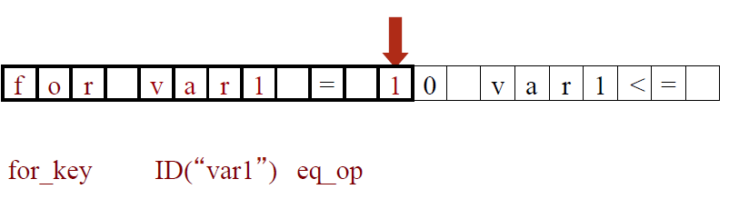
Lexical Analyzer in Action
Dr.Arockia Xavier Annie R, DCSE, Anna University

Slide 21
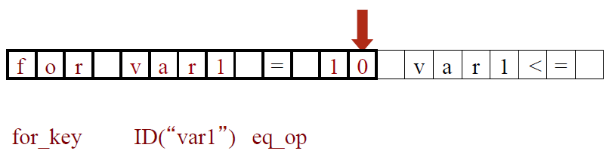
Lexical Analyzer in Action
Dr.Arockia Xavier Annie R, DCSE, Anna University

Slide 22
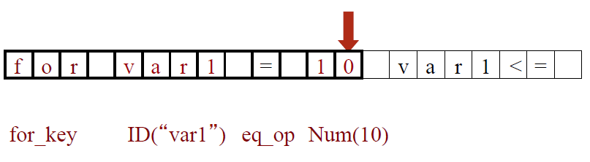
Lexical Analyzer in Action
Dr.Arockia Xavier Annie R, DCSE, Anna University

Slide 23
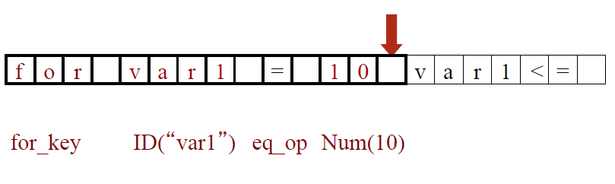
Lexical Analyzer in Action
Dr.Arockia Xavier Annie R, DCSE, Anna University

Slide 24
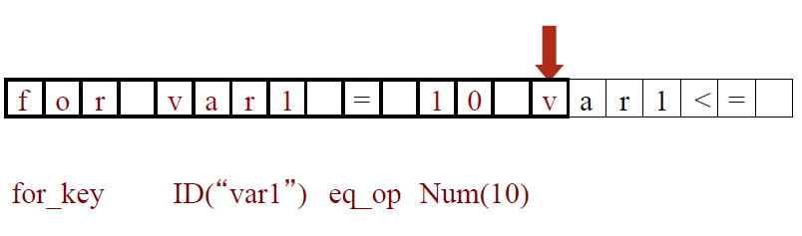
Lexical Analyzer in Action
Dr.Arockia Xavier Annie R, DCSE, Anna University

Slide 25
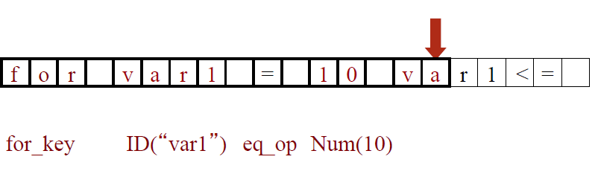
Lexical Analyzer in Action
Dr.Arockia Xavier Annie R, DCSE, Anna University

Slide 26
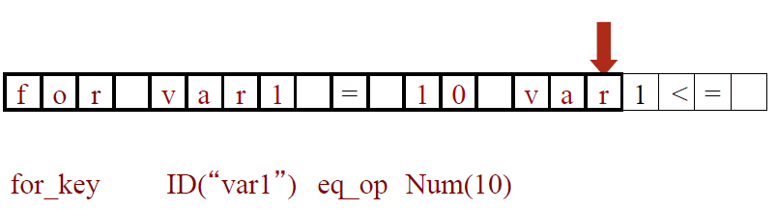
Lexical Analyzer in Action
Dr.Arockia Xavier Annie R, DCSE, Anna University

Slide 27
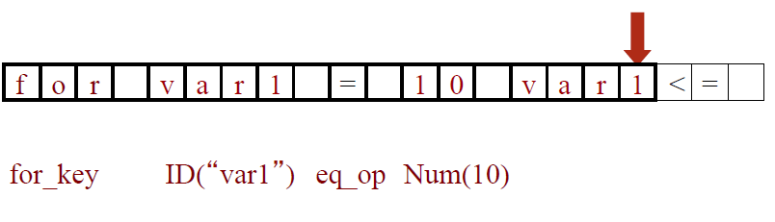
Lexical Analyzer in Action
Dr.Arockia Xavier Annie R, DCSE, Anna University

Slide 28
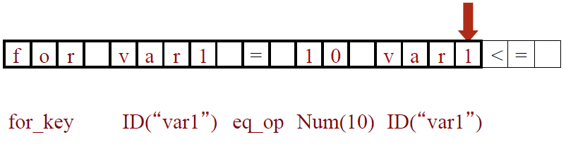
Lexical Analyzer in Action
Dr.Arockia Xavier Annie R, DCSE, Anna University

Slide 29
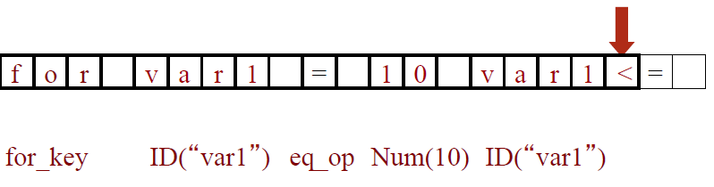
Lexical Analyzer in Action
Dr.Arockia Xavier Annie R, DCSE, Anna University

Slide 30
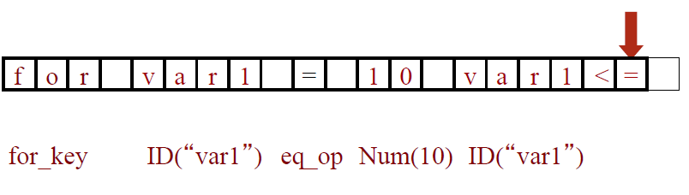
Lexical Analyzer in Action
Dr.Arockia Xavier Annie R, DCSE, Anna University

Slide 31
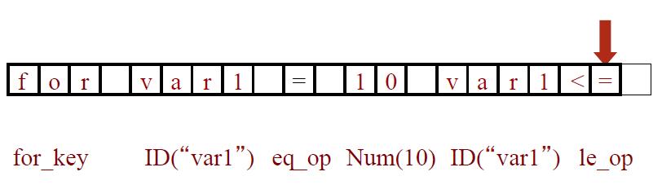
Lexical Analyzer in Action
Dr.Arockia Xavier Annie R, DCSE, Anna University

Slide 32
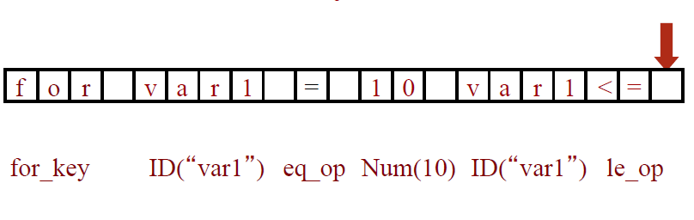
Lexical Analyzer in Action
Dr.Arockia Xavier Annie R, DCSE, Anna University

Slide 33
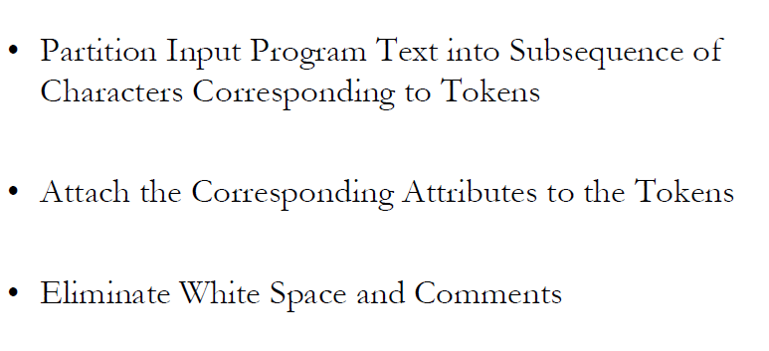
Lexical Analyzer in Action
Dr.Arockia Xavier Annie R, DCSE, Anna University

Slide 34
Tokens, Patterns and Lexemes
A token is a pair a token name and an optional token value
A pattern is a description of the form that the lexemes of a token may take
A lexeme is a sequence of characters in the source program that matches the pattern for a token
Dr.Arockia Xavier Annie R, DCSE, Anna University

Slide 35
Example
Token
Pattern
Sample lexemes
if
Characters i, f
if
else
Characters e, l, s, e
else
comparison
< or > or <= or >= or == or !=
<=, !=
id
Letter followed by letter and digits
pi, score, D2
number
Any numeric constant
3.14159, 0, 6.02e23
literal
Anything but “ sorrounded by “
“values are”
for ( i = 0; i<10; i++)
Dr.Arockia Xavier Annie R, DCSE, Anna University

Slide 36
Attributes for tokens- Example
E = M * C ** 2
  <id, pointer to symbol table entry for E>
  <assign-op>
  <id, pointer to symbol table entry for M>
  <mult-op>
  <id, pointer to symbol table entry for C>
  <exp-op>
  <number, integer value 2>
Dr.Arockia Xavier Annie R, DCSE, Anna University

Slide 37
Outline
Role of lexical analyzer
Specification of tokens
Recognition of tokens
Finite Automata
Lexical analyzer generator
Design of lexical analyzer generator
Dr.Arockia Xavier Annie R, DCSE, Anna University

Slide 38
Specification of tokens
In theory of compilation Regular Expressions are used to formalize the specification of tokens
Regular expressions are means for specifying regular languages
Example:
    letter(letter|digit)* - Specifies ‘identifier’ token.
Each regular expression is a pattern specifying the form of strings
Dr.Arockia Xavier Annie R, DCSE, Anna University

Slide 39
Token
Token represents a set of strings described by a pattern.
Since a token represents more than one lexeme, additional information should be held for that specific lexeme. This additional information is the attribute of the token.
Some attributes:
  <id, attr> where attr is pointer to the symbol table
  <assgop,_> no attribute is needed (if there is only one assignment operator)
  <num, val> where val is the actual value of the number.
Token type and its attribute uniquely identifies a lexeme.
Regular expressions are widely used to specify patterns.
Dr.Arockia Xavier Annie R, DCSE, Anna University

Slide 40
Terminology of Languages (1/2)
Alphabet : a finite set of symbols (ASCII characters)
String :
  Finite sequence of symbols on an alphabet
  Sentence and word are also used in terms of string
  ε is the empty string
  |s| is the length of string s.
Dr.Arockia Xavier Annie R, DCSE, Anna University

Slide 41
Terminology of Languages (2/2)
Language: sets of strings over some fixed alphabet
  ∅ the empty set is a language.
  {ε} the set containing empty string is a language
  The set of well-formed C programs is a language
  The set of all possible identifiers is a language.
Operators on Strings:
  Concatenation: xy represents the concatenation of strings x and y. s ε = s ε s = s
  s^{n} ₌ s s s .. s ( n times) s⁰ ₌ ε
Dr.Arockia Xavier Annie R, DCSE, Anna University

Slide 42
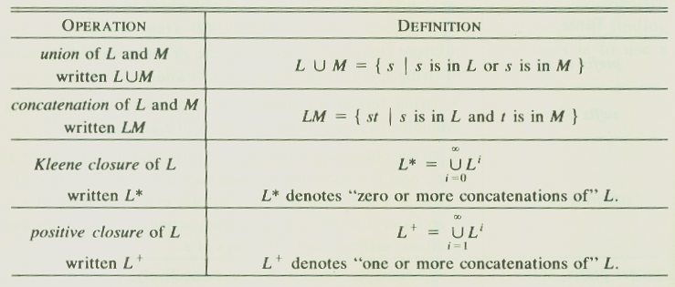
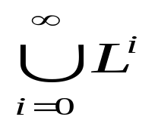
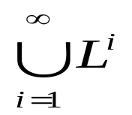
Operations on Languages
Concatenation:
  L₁L₂ = { s₁s₂ | s₁ ∈ L₁ and s₂ ∈ L₂ }
Union
  L₁ ∪ L₂ = { s | s ∈ L₁ or s ∈ L₂ }
Exponentiation:
  L⁰ = {ε} L¹ = L L² = LL
Kleene Closure
  L* =
Positive Closure
  L⁺ =
Dr.Arockia Xavier Annie R, DCSE, Anna University

Slide 43
Example
L₁ = {a,b,c,d} L₂ = {1,2}
L₁L₂ = {a1,a2,b1,b2,c1,c2,d1,d2}
L₁ ∪ L₂ = {a,b,c,d,1,2}
L₁³ = all strings with length three (using a,b,c,d}
L₁* = all strings using letters a,b,c,d and empty string
L₁⁺ = doesn’t include the empty string
Dr.Arockia Xavier Annie R, DCSE, Anna University

Slide 44
Outline
Role of lexical analyzer
Specification of tokens
Recognition of tokens
Finite Automata
Lexical analyzer generator
Design of lexical analyzer generator
Dr.Arockia Xavier Annie R, DCSE, Anna University

Slide 45
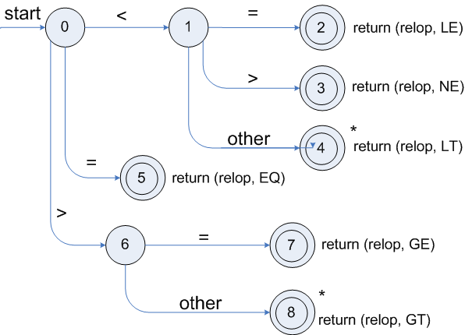
Transition diagrams
Transition diagram for relop
Dr.Arockia Xavier Annie R, DCSE, Anna University

Slide 46
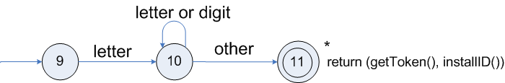
Transition diagrams (cont.)
Transition diagram for reserved words and identifiers
Dr.Arockia Xavier Annie R, DCSE, Anna University

Slide 47
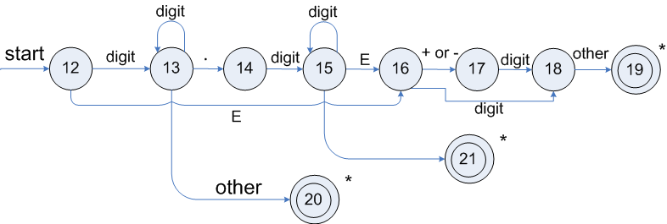
Transition diagrams (cont.)
Transition diagram for unsigned numbers
Dr.Arockia Xavier Annie R, DCSE, Anna University

Slide 48
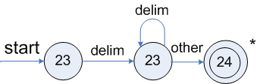
Transition diagrams (cont.)
Transition diagram for whitespace
Dr.Arockia Xavier Annie R, DCSE, Anna University

Slide 49
Regular Expressions
We use regular expressions to describe tokens of a programming language.
A regular expression is built up of simpler regular expressions (using defining rules)
Each regular expression denotes a language.
A language denoted by a regular expression is called as a regular set.
Dr.Arockia Xavier Annie R, DCSE, Anna University

Slide 50
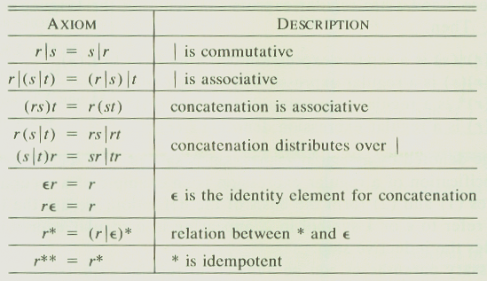
Algebraic Properties of RE
Dr.Arockia Xavier Annie R, DCSE, Anna University

Slide 51
Regular Expressions (Rules)
Regular expressions over alphabet Σ
Reg. Expr Language it denotes
ε {ε}
a∈ Σ {a}
(r₁) | (r₂) L(r₁) ∪ L(r₂)
(r₁) (r₂) L(r₁) L(r₂)
(r)* (L(r))*
(r) L(r)
(r)⁺ = (r)(r)*
(r)? = (r) | ε
Dr.Arockia Xavier Annie R, DCSE, Anna University

Slide 52
Regular Expressions (cont.)
We may remove parentheses by using precedence rules.
  * highest
  concatenation next
  | lowest
ab*|c means (a(b)*)|(c)
Ex:
  Σ = {0,1}
  0|1 => {0,1}
  (0|1)(0|1) => {00,01,10,11}
  0* => {ε ,0,00,000,0000,....}
  (0|1)* => all strings with 0 and 1, including the empty string
Dr.Arockia Xavier Annie R, DCSE, Anna University

Slide 53
Regular Definitions
To write regular expression for some languages can be difficult, because their regular expressions can be quite complex. In those cases, we may use regular definitions.
We can give names to regular expressions, and we can use these names as symbols to define other regular expressions.
A regular definition is a sequence of the definitions of the form:
d₁ → r₁ where d_{i} is a distinct name and
d₂ → r₂ r_{i} is a regular expression over symbols
... Σ∪{d₁,d₂,...,d_{i-1}}
d_{n} → r_{n}
_{not recursive} basic symbols previously defined names
Dr.Arockia Xavier Annie R, DCSE, Anna University

Slide 54
Regular Definitions (cont.)
Ex: Identifiers in Pascal
  letter → A | B | ... | Z | a | b | ... | z
  digit → 0 | 1 | ... | 9
  id → letter (letter | digit ) *
  If we try to write the regular expression representing identifiers without using regular definitions, that regular expression will be complex.
  (A|...|Z|a|...|z) ( (A|...|Z|a|...|z) | (0|...|9) ) *
Dr.Arockia Xavier Annie R, DCSE, Anna University

Slide 55
Outline
Role of lexical analyzer
Specification of tokens
Recognition of tokens
Finite Automata
Lexical analyzer generator
Design of lexical analyzer generator
Dr.Arockia Xavier Annie R, DCSE, Anna University

Slide 56
Finite Automata
A recognizer for a language is a program that takes a string x, and answers “yes” if x is a sentence of that language, and “no” otherwise.
We call the recognizer of the tokens as a finite automaton.
A finite automaton can be: deterministic(DFA) or non-deterministic (NFA)
This means that we may use a deterministic or non-deterministic automaton as a lexical analyzer.
Both deterministic and non-deterministic finite automaton recognize regular sets.
Dr.Arockia Xavier Annie R, DCSE, Anna University

Slide 57
Finite Automata
NFA or DFA?
  deterministic – faster recognizer, but it may take more space
  non-deterministic – slower, but it may take less space
  Deterministic automatons are widely used in lexical analyzers.
First, we define regular expressions for tokens; Then we convert them into a DFA to get a lexical analyzer for our tokens.
  Algorithm1: Regular Expression ➔ NFA ➔ DFA (two steps: first to NFA, then to DFA)
  Algorithm2: Regular Expression ➔ DFA (directly convert a regular expression into a DFA)
Dr.Arockia Xavier Annie R, DCSE, Anna University

Slide 58
Non-Deterministic Finite Automaton (NFA)
A non-deterministic finite automaton (NFA) is a mathematical model that consists of:
  S - a set of states
  Σ - a set of input symbols (alphabet)
  move – a transition function move to map state-symbol pairs to sets of states.
  s₀ - a start (initial) state
  F – a set of accepting states (final states)
ε- transitions are allowed in NFAs. In other words, we can move from one state to another one without consuming any symbol.
A NFA accepts a string x, if and only if there is a path from the starting state to one of accepting states such that edge labels along this path spell out x.
Dr.Arockia Xavier Annie R, DCSE, Anna University

Slide 59

0 is the start state s₀
{2} is the set of final states F
= {a,b}
S = {0,1,2}
Transition Function: a b
0 {0,1} {0}
1 _ {2}
2 _ _
a
a
b
0
1
2
start
b
Transition graph of the NFA
The language recognized by this NFA is (a|b) * a b
Dr.Arockia Xavier Annie R, DCSE, Anna University

Slide 60
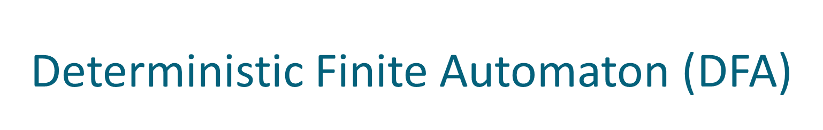
A Deterministic Finite Automaton (DFA) is a special form of a NFA.
no state has ε- transition
for each symbol a and state s, there is at most one labeled edge a leaving s.
i.e. transition function is from pair of state-symbol to state (not set of states)
a
b
a
The language recognized by
this DFA is also (a|b) * a b
a
b
0
1
2
b
Dr.Arockia Xavier Annie R, DCSE, Anna University

Slide 61
Implementing a NFA
  S ⬅ ε-closure({s₀}) { set all of states can be accessible from s₀ by ε-transitions }
  c ⬅ nextchar
  while (c != eos) {
  begin
  s ⬅ ε-closure(move(S,c)) { set of all states can be accessible from a state in S
  c ⬅ nextchar by a transition on c }
  end
  if (S∩F != Φ) then { if S contains an accepting state }
  return “yes”
  else
  return “no”
Dr.Arockia Xavier Annie R, DCSE, Anna University

Slide 62
Implementing a DFA
Le us assume that the end of a string is marked with a special symbol (say eos). The algorithm for recognition will be as follows: (an efficient implementation)
  s ⬅ s₀ { start from the initial state }
  c ⬅ nextchar { get the next character from the input string }
  while (c != eos) do { do until the endof the string }
  begin
  s ⬅ move(s,c) { transition function }
  c ⬅ nextchar
  end
  if (s in F) then { if s is an accepting state }
  return “yes”
  else
  return “no”
Dr.Arockia Xavier Annie R, DCSE, Anna University

Slide 63
Recap
Lexical Analyzer
  Scanner
  Tokens – Patterns – Lexemes
  Transition diagrams
  Regular Expressions and Regular Definitions
  Finite Automata
    NFA and DFA
Next Class
RE to NFA / NFA to DFA / RE to DFA
Dr.Arockia Xavier Annie R, DCSE, Anna University

Slide 64
Questions???
Dr.Arockia Xavier Annie R, DCSE, Anna University

Slide 65
Dr. Arockia Xavier Annie R
Asst. Professor, DCSE
CEG, Anna University
Chennai -600025
Email: annie@annauniv.edu

Slide 66
Outline
RE to NFA
NFA to DFA
RE to DFA
Minimizing DFA
Lexical analyzer generator
Design of lexical analyzer generator
Dr.Arockia Xavier Annie R, DCSE, Anna University

Slide 67
Converting A Regular Expression into NFA (Thomson’s Construction)
This is one way to convert a regular expression into a NFA.
There can be other ways (much efficient) for the conversion.
Thomson’s Construction is simple and systematic method.
  It guarantees that the resulting NFA will have exactly one final state, and one start state.
Construction starts from simplest parts (alphabet symbols).
  To create a NFA for a complex regular expression, NFAs of its sub-expressions are combined to create its NFA
Dr.Arockia Xavier Annie R, DCSE, Anna University

Slide 68

ε
To recognize an empty string ε
To recognize a symbol a in the alphabet Σ
i
f
a
i
f
If N(r₁) and N(r₂) are NFAs for regular expressions r₁ and r₂
  For regular expression r₁ | r₂
ε
N(r₁)
ε
NFA for r₁ | r₂
i
ε
f
ε
N(r₂)
Dr.Arockia Xavier Annie R, DCSE, Anna University

Slide 69
For regular expression r₁ r₂
Final state of N(r₂) become final state of N(r₁r₂)
i
N(r₁)
N(r₂)
f
NFA for r₁ r₂
For regular expression r*
ε
ε
ε
i
N(r)
f
ε
NFA for r*
Dr.Arockia Xavier Annie R, DCSE, Anna University

Slide 70

a:
a
a
ε
ε
(a | b)
ε
ε
b:
b
b
ε
a
ε
ε
(a|b) *
ε
ε
ε
ε
b
ε
ε
a
ε
ε
(a|b) * a
ε
ε
a
ε
ε
b
ε
Dr.Arockia Xavier Annie R, DCSE, Anna University

Slide 71
Converting a NFA into a DFA (subset constr)
  put ε-closure({s₀}) as an unmarked state into the set of DFA (DS)
  while (there is one unmarked S₁ in DS) do
  begin
  mark S₁
  for each input symbol a do
  begin
  S₂ ⬅ ε-closure(move(S₁,a))
  if (S₂ is not in DS) then
  add S₂ into DS as an unmarked state
  transfunc[S₁,a] ⬅ S₂
  end
  end
a state S in DS is an accepting state of DFA if a state in S is an accepting state of NFA
the start state of DFA is ε-closure({s₀})
ε-closure({s₀}) is the set of all states can be accessible
from s₀ by ε-transition.
set of states to which there is a transition on
a from a state s in S₁
Dr.Arockia Xavier Annie R, DCSE, Anna University

Slide 72

2
a
3
ε
ε
0
ε
1
ε
a
ε
6
7
8
ε
4
b
5
ε
S₀ = ε-closure({0}) = {0,1,2,4,7} S₀ into DS as an unmarked state
⇓ mark S₀
ε-closure(move(S₀,a)) = ε-closure({3,8}) = {1,2,3,4,6,7,8} = S₁ S₁ into DS
ε-closure(move(S₀,b)) = ε-closure({5}) = {1,2,4,5,6,7} = S₂ S₂ into DS
transfunc[S₀,a] ⬅ S₁ transfunc[S₀,b] ⬅ S₂
⇓ mark S₁
ε-closure(move(S₁,a)) = ε-closure({3,8}) = {1,2,3,4,6,7,8} = S₁
ε-closure(move(S₁,b)) = ε-closure({5}) = {1,2,4,5,6,7} = S₂
transfunc[S₁,a] ⬅ S₁ transfunc[S₁,b] ⬅ S₂
⇓ mark S₂
ε-closure(move(S₂,a)) = ε-closure({3,8}) = {1,2,3,4,6,7,8} = S₁
ε-closure(move(S₂,b)) = ε-closure({5}) = {1,2,4,5,6,7} = S₂
transfunc[S₂,a] ⬅ S₁ transfunc[S₂,b] ⬅ S₂
Dr.Arockia Xavier Annie R, DCSE, Anna University

Slide 73

S₀ is the start state of DFA since 0 is a member of S₀={0,1,2,4,7}
S₁ is an accepting state of DFA since 8 is a member of S₁ = {1,2,3,4,6,7,8}
a
S₁
a
S₀
b
a
b
S₂
b
Dr.Arockia Xavier Annie R, DCSE, Anna University

Slide 74
Converting Regular Expressions Directly to DFAs
We may convert a regular expression into a DFA (without creating a NFA first).
First we augment the given regular expression by concatenating it with a special symbol #.
r ➔ (r)# augmented regular expression
Then, we create a syntax tree for this augmented regular expression.
In this syntax tree, all alphabet symbols (plus # and the empty string) in the augmented regular expression will be on the leaves, and all inner nodes will be the operators in that augmented regular expression.
Then each alphabet symbol (plus #) will be numbered (position numbers).
Dr.Arockia Xavier Annie R, DCSE, Anna University

Slide 75

(a|b) * a ➔ (a|b) * a # augmented regular expression
•
Syntax tree of (a|b) * a #
each symbol is numbered (positions)
each symbol is at a leave
inner nodes are operators
•
#
4
*
a
3
|
a
b
1
2
Dr.Arockia Xavier Annie R, DCSE, Anna University

Slide 76

Then we define the function followpos for the positions (positions
assigned to leaves).
followpos(i) -- is the set of positions which can follow
the position ‘i’ in the strings generated by
the augmented regular expression.
For example, ( a | b) * a #
1 2 3 4
followpos(1) = {1,2,3}
followpos(2) = {1,2,3}
followpos(3) = {4}
followpos(4) = {}
followpos is just defined for leaves,
it is not defined for inner nodes.
Dr.Arockia Xavier Annie R, DCSE, Anna University

Slide 77
firstpos, lastpos, nullable
To evaluate followpos, we need three more functions to be defined for the nodes (not just for leaves) of the syntax tree.
firstpos(n) -- the set of the positions of the first symbols of strings generated by the sub-expression rooted by n.
lastpos(n) -- the set of the positions of the last symbols of strings generated by the sub-expression rooted by n.
nullable(n) -- true if the empty string is a member of strings generated by the sub expression rooted by n false otherwise
Dr.Arockia Xavier Annie R, DCSE, Anna University

Slide 78

n | nullable(n) | firstpos(n) | lastpos(n)
leaf labeled ε | true | Φ | Φ
leaf labeled with position i | false | {i} | {i}
| c₁ c₂ | nullable(c₁) or nullable(c₂) | firstpos(c₁) ∪ firstpos(c₂) | lastpos(c₁) ∪ lastpos(c₂)
• c₁ c₂ | nullable(c₁) and nullable(c₂) | if (nullable(c₁)) firstpos(c₁) ∪ firstpos(c₂) else firstpos(c₁) | if (nullable(c₂)) lastpos(c₁) ∪ lastpos(c₂) else lastpos(c₂)
* c₁ | true | firstpos(c₁) | lastpos(c₁)
Dr.Arockia Xavier Annie R, DCSE, Anna University

Slide 79
How to evaluate followpos
Two-rules define the function followpos:
If n is concatenation-node with left child c₁ and right child c₂, and i is a position in lastpos(c₁), then all positions in firstpos(c₂) are in followpos(i).
If n is a star-node, and i is a position in lastpos(n), then all positions in firstpos(n) are in followpos(i).
If firstpos and lastpos have been computed for each node, followpos of each position can be computed by making one depth-first traversal of the syntax tree.
Dr.Arockia Xavier Annie R, DCSE, Anna University

Slide 80

{1,2,3}
pink – firstpos
blue – lastpos
•
{4}
{1,2,3}
{3}
{4}
{4}
•
#
4
{1,2}
{1,2}
{3}
{3}
*
a
3
Then we can calculate followpos
followpos(1) = {1,2,3}
followpos(2) = {1,2,3}
followpos(3) = {4}
followpos(4) = {}
{1,2}
|
{1,2}
{1}
a
{1}
{2}
b
{2}
1
2
After we calculate follow positions, we are ready to create DFA
for the regular expression.
Dr.Arockia Xavier Annie R, DCSE, Anna University

Slide 81
Algorithm (RE ➔ DFA)
Create the syntax tree of (r) #
Calculate the functions: followpos, firstpos, lastpos, nullable
Put firstpos(root) into the states of DFA as an unmarked state.
while (there is an unmarked state S in the states of DFA) do
  mark S
  for each input symbol a do
    let s₁,...,s_{n} are positions in S and symbols in those positions are a
    S’ ⬅ followpos(s₁) ∪ ... ∪ followpos(s_{n})
    move(S,a) ⬅ S’
    if (S’ is not empty and not in the states of DFA)
      put S’ into the states of DFA as an unmarked state.
the start state of DFA is firstpos(root)
the accepting states of DFA are all states containing the position of #
Dr.Arockia Xavier Annie R, DCSE, Anna University

Slide 82
Example -- ( a | b) * a #
1 2 3 4
followpos(1)={1,2,3} followpos(2)={1,2,3} followpos(3)={4} followpos(4)={}
S₁=firstpos(root)={1,2,3}
⇓ mark S₁
a: followpos(1) ∪ followpos(3)={1,2,3,4}=S₂ move(S₁,a)=S₂
b: followpos(2)={1,2,3}=S₁ move(S₁,b)=S₁
⇓ mark S₂
a: followpos(1) ∪ followpos(3)={1,2,3,4}=S₂ move(S₂,a)=S₂
b: followpos(2)={1,2,3}=S₁ move(S₂,b)=S₁
start state: S₁
accepting states: {S₂}
b
a
a
S₁
S₂
b
Dr.Arockia Xavier Annie R, DCSE, Anna University

Slide 83

1 2 3 4
followpos(1)={2} followpos(2)={3,4} followpos(3)={3,4} followpos(4)={}
S₁=firstpos(root)={1,2}
⇓ mark S₁
a: followpos(1)={2}=S₂ move(S₁,a)=S₂
b: followpos(2)={3,4}=S₃ move(S₁,b)=S₃
⇓ mark S₂
b: followpos(2)={3,4}=S₃ move(S₂,b)=S₃
⇓ mark S₃
c: followpos(3)={3,4}=S₃ move(S₃,c)=S₃
start state: S₁
accepting states: {S₃}
S₂
a
b
S₁
b
S₃
c
Dr.Arockia Xavier Annie R, DCSE, Anna University

Slide 84
Minimizing Number of States of a DFA
partition the set of states into two groups:
  G₁ : set of accepting states
  G₂ : set of non-accepting states
For each new group G
  partition G into subgroups such that states s₁ and s₂ are in the same group iff
  for all input symbols a, states s₁ and s₂ have transitions to states in the same group.
Start state of the minimized DFA is the group containing the start state of the original DFA.
Accepting states of the minimized DFA are the groups containing the accepting states of the original DFA.
Dr.Arockia Xavier Annie R, DCSE, Anna University

Slide 85

a
G₁ = {2}
G₂ = {1,3}
G₂ cannot be partitioned because
move(1,a)=2 move(1,b)=3
move(3,a)=2 move(2,b)=3
2
a
1
b
a
b
3
b
So, the minimized DFA (with minimum states)
b
a
{1,3}
a
{2}
b
Dr.Arockia Xavier Annie R, DCSE, Anna University

Slide 86

a
2
a
a
Groups: {1,2,3} {4}
1
b
4
b
a
a b
1->2 1->3
2->2 2->3
3->4 3->3
{1,2}
{3}
3
b
no more partitioning
b
So, the minimized DFA
b
a
{3}
b
{1,2}
a
b
a
{4}
Dr.Arockia Xavier Annie R, DCSE, Anna University

Slide 87
Some Other Issues in Lexical Analyzer
The lexical analyzer has to recognize the longest possible string.
  Ex: identifier newval -- n ne new newv newva newval
What is the end of a token? Is there any character which marks the end of a token?
  It is normally not defined.
  If the number of characters in a token is fixed, in that case no problem: + -
  But < ➔ < or <> (in Pascal)
  The end of an identifier : the characters cannot be in an identifier can mark the end of token.
  We may need a lookhead
    In Prolog: p :- X is 1. p :- X is 1.5. The dot followed by a white space character can mark the end of a number. But if that is not the case, the dot must be treated as a part of the number.
Dr.Arockia Xavier Annie R, DCSE, Anna University

Slide 88
Some Issues in Lexical Analyzer (cont.)
Skipping comments
  Normally we don’t return a comment as a token.
  We skip a comment, and return the next token (which is not a comment) to the parser.
  So, the comments are only processed by the lexical analyzer, and the don’t complicate the syntax of the language.
Symbol table interface
  symbol table holds information about tokens (at least lexeme of identifiers)
  how to implement the symbol table, and what kind of operations.
    hash table – open addressing, chaining
    putting into the hash table, finding the position of a token from its lexeme.
Positions of the tokens in the file (for the error handling).
Dr.Arockia Xavier Annie R, DCSE, Anna University

Slide 89
Architecture of a transition-diagram-based lexical analyzer
TOKEN getRelop()
{
TOKEN retToken = new (RELOP)
while (1) { /* repeat character processing until a
return or failure occurs */
switch(state) {
case 0: c= nextchar();
if (c == ‘<‘) state = 1;
else if (c == ‘=‘) state = 5;
else if (c == ‘>’) state = 6;
else fail(); /* lexeme is not a relop */
break;
case 1: …
…
case 8: retract();
retToken.attribute = GT;
return(retToken);
}
Dr.Arockia Xavier Annie R, DCSE, Anna University

Slide 90
Lexical Analyzer Generator - Lex
Lex Source program
lex.l
Lexical Compiler
lex.yy.c
C
compiler
lex.yy.c
a.out
a.out
Sequence of tokens
Input stream
Dr.Arockia Xavier Annie R, DCSE, Anna University

Slide 91

Structure of Lex programs
declarations
%%
translation rules
%%
auxiliary functions
Pattern {Action}
Dr.Arockia Xavier Annie R, DCSE, Anna University

Slide 92
Example
%{
/* definitions of manifest constants
LT, LE, EQ, NE, GT, GE,
IF, THEN, ELSE, ID, NUMBER, RELOP */
%}
/* regular definitions
delim [ \t\n]
ws {delim}+
letter [A-Za-z]
digit [0-9]
id {letter}({letter}|{digit})*
number {digit}+(\.{digit}+)?(E[+-]?{digit}+)?
%%
{ws} {/* no action and no return */}
if {return(IF);}
then {return(THEN);}
else {return(ELSE);}
{id} {yylval = (int) installID(); return(ID); }
{number} {yylval = (int) installNum(); return(NUMBER);}
…
Int installID() {/* funtion to install the lexeme, whose first character is pointed to by yytext, and whose length is yyleng, into the symbol table and return a pointer thereto */
}
Int installNum() { /* similar to installID, but puts numerical constants into a separate table */
}
Dr.Arockia Xavier Annie R, DCSE, Anna University

Slide 93
Finite Automata
Regular expressions = specification
Finite automata = implementation
A finite automaton consists of
  An input alphabet Σ
  A set of states S
  A start state n
  A set of accepting states F ⊆ S
  A set of transitions state →^{input} state
Dr.Arockia Xavier Annie R, DCSE, Anna University

Slide 94
Finite Automata
Transition
s₁ →ª s₂
Is read
  In state s₁ on input “a” go to state s₂
If end of input
  If in accepting state => accept, othewise => reject
If no transition possible => reject
Dr.Arockia Xavier Annie R, DCSE, Anna University

Slide 95
Finite Automata State Graphs
A state
The start state
An accepting state
a
A transition
Dr.Arockia Xavier Annie R, DCSE, Anna University

Slide 96
A Simple Example
A finite automaton that accepts only “1”
A finite automaton accepts a string if we can follow transitions labeled with the characters in the string from the start to some accepting state
1
Dr.Arockia Xavier Annie R, DCSE, Anna University

Slide 97
Another Simple Example
A finite automaton accepting any number of 1’s followed by a single 0
Alphabet: {0,1}
Check that “1110” is accepted but “110…” is not
1
0
Dr.Arockia Xavier Annie R, DCSE, Anna University

Slide 98
And Another Example
Alphabet {0,1}
What language does this recognize?
1
0
0
0
1
1
Dr.Arockia Xavier Annie R, DCSE, Anna University

Slide 99
And Another Example
Alphabet still { 0, 1 }
The operation of the automaton is not completely defined by the input
  On input “11” the automaton could be in either state
1
1
Dr.Arockia Xavier Annie R, DCSE, Anna University

Slide 100
Epsilon Moves
Another kind of transition: ε-moves
ε
A
B
Machine can move from state A to state B without reading input
Dr.Arockia Xavier Annie R, DCSE, Anna University

Slide 101
Deterministic and Nondeterministic Automata
Deterministic Finite Automata (DFA)
  One transition per input per state
  No ε-moves
Nondeterministic Finite Automata (NFA)
  Can have multiple transitions for one input in a given state
  Can have ε-moves
Finite automata have finite memory
  Need only to encode the current state
Dr.Arockia Xavier Annie R, DCSE, Anna University

Slide 102
Execution of Finite Automata
A DFA can take only one path through the state graph
  Completely determined by input
NFAs can choose
  Whether to make ε-moves
  Which of multiple transitions for a single input to take
Dr.Arockia Xavier Annie R, DCSE, Anna University

Slide 103
Acceptance of NFAs
An NFA can get into multiple states
1
0
1
0
Input:
1
0
1
Rule: NFA accepts if it can get in a final state
Dr.Arockia Xavier Annie R, DCSE, Anna University

Slide 104
NFA vs. DFA (1)
NFAs and DFAs recognize the same set of languages (regular languages)
DFAs are easier to implement
  There are no choices to consider
Dr.Arockia Xavier Annie R, DCSE, Anna University

Slide 105
NFA vs. DFA (2)
For a given language the NFA can be simpler than the DFA
1
0
0
NFA
0
1
0
0
0
DFA
1
1
DFA can be exponentially larger than NFA
Dr.Arockia Xavier Annie R, DCSE, Anna University

Slide 106
Regular Expressions to Finite Automata
High-level sketch
NFA
Regular
expressions
DFA
Lexical
Specification
Table-driven
Implementation of DFA
Dr.Arockia Xavier Annie R, DCSE, Anna University

Slide 107
Regular Expressions to NFA (1)
For each kind of rexp, define an NFA
  Notation: NFA for rexp A
A
For ε
ε
For input a
a
Dr.Arockia Xavier Annie R, DCSE, Anna University

Slide 108
Regular Expressions to NFA (2)
For AB
ε
A
B
For A | B
B
ε
ε
ε
ε
A
Dr.Arockia Xavier Annie R, DCSE, Anna University

Slide 109
Regular Expressions to NFA (3)
For A*
ε
A
ε
ε
Dr.Arockia Xavier Annie R, DCSE, Anna University

Slide 110
Example of RegExp -> NFA conversion
Consider the regular expression
  (1 | 0)*1
The NFA is
ε
1
ε
ε
C
E
A
B
1
ε
0
G
H
ε
I
J
ε
D
F
ε
ε
Dr.Arockia Xavier Annie R, DCSE, Anna University

Slide 111
Next
NFA
Regular
expressions
DFA
Lexical
Specification
Table-driven
Implementation of DFA
Dr.Arockia Xavier Annie R, DCSE, Anna University

Slide 112
NFA to DFA. The Trick
Simulate the NFA
Each state of resulting DFA
  = a non-empty subset of states of the NFA
Start state
  = the set of NFA states reachable through ε-moves from NFA start state
Add a transition S →ª S’ to DFA iff
  S’ is the set of NFA states reachable from the states in S after seeing the input a
    considering ε-moves as well
Dr.Arockia Xavier Annie R, DCSE, Anna University

Slide 113
NFA -> DFA Example
ε
1
ε
ε
C
E
A
B
1
ε
0
G
H
ε
I
J
ε
D
F
ε
ε
0
0
FGABCDHI
0
1
ABCDHI
1
1
EJGABCDHI
Dr.Arockia Xavier Annie R, DCSE, Anna University

Slide 114
NFA to DFA. Remark
An NFA may be in many states at any time
How many different states ?
If there are N states, the NFA must be in some subset of those N states
How many non-empty subsets are there?
  2^{N} - 1 = finitely many, but exponentially many
Dr.Arockia Xavier Annie R, DCSE, Anna University

Slide 115
Implementation
A DFA can be implemented by a 2D table T
  One dimension is “states”
  Other dimension is “input symbols”
  For every transition S_{i} →ª S_{k} define T[i,a] = k
DFA “execution”
  If in state S_{i} and input a, read T[i,a] = k and skip to state S_{k}
  Very efficient
Dr.Arockia Xavier Annie R, DCSE, Anna University

Slide 116
Table Implementation of a DFA
0
0
T
0
1
S
1
1
U
 | 0 | 1
S | T | U
T | T | U
U | T | U
Dr.Arockia Xavier Annie R, DCSE, Anna University

Slide 117
Implementation (Cont.)
NFA -> DFA conversion is at the heart of tools such as flex or jflex
But, DFAs can be huge
In practice, flex-like tools trade off speed for space in the choice of NFA and DFA representations
Dr.Arockia Xavier Annie R, DCSE, Anna University

Slide 118
Dr.Arockia Xavier Annie R, DCSE, Anna University

Slide 119
Lexical errors
Some errors are out of power of lexical analyzer to recognize:
  fi (a == f(x)) …
However it may be able to recognize errors like:
  d = 2r
Such errors are recognized when no pattern for tokens matches a character sequence
Dr.Arockia Xavier Annie R, DCSE, Anna University

Slide 120
Error recovery
Panic mode: successive characters are ignored until we reach to a well formed token
Delete one character from the remaining input
Insert a missing character into the remaining input
Replace a character by another character
Transpose two adjacent characters
Dr.Arockia Xavier Annie R, DCSE, Anna University

Slide 121
Input buffering
Sometimes lexical analyzer needs to look ahead some symbols to decide about the token to return
  In C language: we need to look after -, = or < to decide what token to return
  In Fortran: DO 5 I = 1.25
We need to introduce a two buffer scheme to handle large look-aheads safely
E = M * C * * 2 eof
Dr.Arockia Xavier Annie R, DCSE, Anna University

Slide 122
Sentinels
E = M eof * C * * 2 eof
eof
Switch (*forward++) {
case eof:
if (forward is at end of first buffer) {
reload second buffer;
forward = beginning of second buffer;
}
else if {forward is at end of second buffer) {
reload first buffer;\
forward = beginning of first buffer;
}
else /* eof within a buffer marks the end of input */
terminate lexical analysis;
break;
cases for the other characters;
}
Dr.Arockia Xavier Annie R, DCSE, Anna University

Slide 123
Why to separate Lexical analysis and parsing
Simplicity of design
Improving compiler efficiency
Enhancing compiler portability
Dr.Arockia Xavier Annie R, DCSE, Anna University

